Slide 1
PUBP309: EDUCATION POLICY
Shivakumar Jolad
FLAME University
Compulsory Education Debates in Colonial India 1792-1920
(PARIMALA RAO)

Slide 2
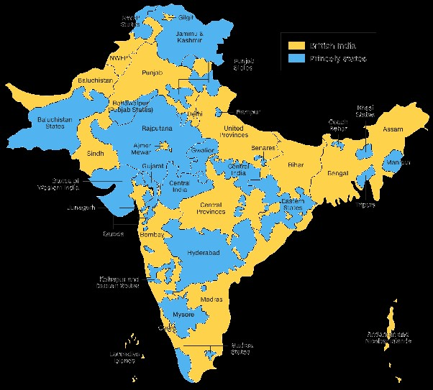
British 60% , 565 Princely States 40%

Slide 3
A Pre- history of Compulsory Education Debates Why Introduce Modern Education for All?
1. 1792 Charles Grant
A. Famine, B. Superstitious Practices
C. Social reform- abolition of sati – child rights
2. 1820s debates – Empower Indians / strengthen
A. Rural population against feudal oppression
B. To give voice to Indians in the administration
C. To prepare them for future independence
3. National Education 1838-1850
Adopting indigenous schools, expansion of primary education
3. Mass Education 1868-70 – govt initiative
4. Education of Tribal, Low Caste, minority, Girl’s Education
5. Gokhale’s Compulsory Education Bill 1911

Slide 4
1. Charles Grant 1792
Grant (1746) son of Scot highland soldier in the Jacobite army, revolted against ‘English rule’/ orphan/ India in 1767/ cadet
Famine of 1768-70, 3 million deaths - ‘sold their children; especially daughters in times of distresses. … the sight of infants hovering over their dead parents, and the death of entire population of villages.’ large network of schools
Observations – 1792, located ‘the death and devastation to the out-dated method of cultivation’ –
‘We have appropriated those territories in perpetuity to ourselves, we have assumed sovereign dominion over them. (So) all duties of rulers must be incumbent upon us. ... (these duties are to protect people from) feudal oppression and official abuses.’

Slide 5
1. Modern education would introduce ‘new and improved methods of agriculture, protect the peasants from recurring famines’ Indians are very receptive to new technologies
2. Prevention of Sati- ‘the Hindus err because they are ignorant’
English officials – ‘we have promised perfect religious neutrality to the Hindus … will not inter fear in the internal affairs of the Hindoo society.’
Grant returned to Britain, became one of the 24 directors of the EIC/ MP
Submitted ‘Observations’ to British Parliament in 1812
1813 – 1 lakhs rupees a year British admin did not use 1813-1820 / 2021 – 2 Sanskrit Colleges Poona, Calcutta

Slide 6
2. Education as Empowering tool : The 1820s debate ‘On the employment of natives in the public service,’ - 31 Dec 1824.
Thomas Munro - ‘India has no political freedom, no voice in framing laws or imposing taxes.’
‘Exclusion of natives from higher positions is both politically and morally wrong. … They are altogether more efficient men of business.’
300 primary - Tahsildari, 40 secondary – Collectorate Schools
Death in 1827 - 80 primary/20 secondary
Purusavakam -10 Christian, 21 Shudra; Pettah Telugu - 13 Brahmin, 12 Shudra, 6 Modali, 4 Maratha, and 3 Komati; Ramnad Collectorate 30 Brahmin, 50 non-Brahmin children
Tamil, Telugu, Kannada, Malayalam + English, Mathematics, elementary science. All schools closed in 1836

Slide 7
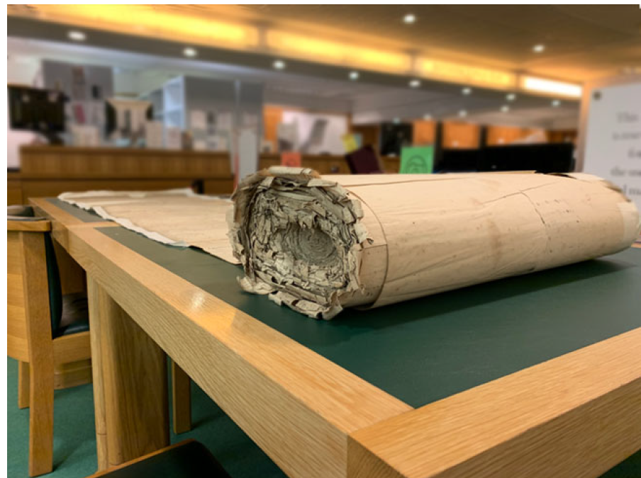
1839 Madras Petition for reopening Munro’s Schools – 70,000 signatures

Slide 8
Scottish MPs 1830-33, T.B. Macaulay, Charles, Robert Grant, Joseph Hume
Demanded elected Indian MPs in British Parliament
Renewal of Charter 1833 ‘no person, by reason of his birth, creed, or colour, should be disqualified from holding any office in the service of the East India Company.’
M- ‘Judicial reforms in India to prevent the British officers from treating all the native population as parias.’
M- ‘The day on which Britain gave its independence to India would be the proudest day in English history.’
Set up Anglo-Vernacular Schools Ajmer, Azamgarh, Bareli, Dacca, Farukabad, Ghazipur, Gorakhpur, Jaunpur, Jabalpur, and raised the standard of existing local schools at Bhagalpur, Meerut and Sagar. /Inclusive classrooms Dalit and Brahmin students
Appointed Radhakant Deb and Russomoy Dutt to Edu Dept/ GG Executive Council

Slide 9
Macaulay’s Minute - 3 July 1836 Compulsory teaching of mother tongue
‘I stress on the teaching of vernacular in our English schools...in fact, their knowing how to read and write their mother tongue will, very greatly facilitate their English studies. Indeed I conceive that an order to give instruction in the English language is, by necessary implication, an order to give instruction where that instruction is required in the vernacular language. ‘
‘Teaching the boys at Ajmer, to read and write the Hindi language seems to me to be a bona fide part of an English education.’
Macaulay – 3 years 7 months 7 days in India 10 June 1834 – 17 January 1838
Macaulay’s Minute 7 March 1835-17 January 1838 = 2yrs, 10months, 10 days

Slide 10
Empowerment at the local level
Krishnamohan Banerjee,
‘A ryot that can read and write may be able to sign his own name in his koboolut (written consent to rent agreement) after reading it himself, may examine the pattah (land deed) or the dakhila (receipt for money) granted to him and the entries made in the Zamindar’s books when he takes izarah (lease of land held at a defined rent) or pays rent, may when wronged write out an application to the proper authority without the intervention of a Court sharper in the form of a professional scribe, may read for himself depositions taken in his name and affix his own signature, and in various other ways check the delinquencies of oppressors, forgers, and perjurers.’

Slide 11
Schools in Every Village
Judge of Jessore, W. Seton-Karr, suggested village schools
‘enable a peasant to write a letter of business, to draw out a bond, to understand the terms of a mortgage, to cast up his accounts to know if his receipts for rent are correctly signed.’
Gov / Bengal /John Peter Grant,
‘Curriculum in primary schools besides teaching reading, writing, and arithmetic should consist of ‘Agricultural and Commercial Accounts, Quittance of Rents, Bonds, modes of formal letters. ... The above course will enable any lad of ordinary intelligence to read and write correctly and to see that he is not cheated in his accounts by the Mahajan or the agent of the Zamindar.’

Slide 12
Robert Shortrede’s schools Purandhar Taluka 1843
Castes | No of Students
Kunbi | 408
Brahmin | 338
Wani | 87
OBC- Kasar, Navi, Teli, etc | 168
Muslim | 32
Dalit-Chambhar | 11
Mahar | 3+3 girls
Mang | 1
Others | 64
‘People can understand their own affairs and vigilantly observe and scrutinize the conduct of the native functionaries n successfully resist all unauthorized actions by seeing that the sums paid by them to govt were properly entered in their Receipt Books ….It would be a powerful and operative check on the native functionaries.’
Mulberry cultivation

Slide 13
‘National Education’ of Trevelyan 1838
‘The time has arrived for taking up the question of national education … All we need to do is to bring people together, they will form into a nation’
National Education - English medium schools with compulsory vernacular and one classical language Sanskrit/Arabic/Persian
‘Just as Britain was benefitted by the study of Greek and Latin, India would be benefitted by the study of English’
Colonial State -Indians should be empowered through education but not enough to overthrow the Brit administration.
Ellenborough - ‘If these gentlemen (Macaulay, Trevelyan and others) who wish to educate the natives of India were to succeed to the utmost extent of their desire, we should not remain in this country three months.’

Slide 14
Policy of Incorporation- 1840-1882
Macaulay’s Minute was replaced by Auckland’s Education Minute 24 Nov 1839
All Macaulay’s schools closed down/ Bareilly – saved by Nawab of Rampur + local people
Auckland - for setting up a ‘National System of Education for the entire country based on the foundation of indigenous schools’
Adopted 70,000 indigenous schools 1840-1881 - gave 1 month teacher training on how to maintain attendance register, prepare quarterly and annual reports, use maps and globs to teach geography.
5 rupees a month as salary/ pension after completing 20 years of service
Curriculum – indigenous curriculum (language, literature, arithmetic) + geography and history/ No English – Class 1-7

Slide 15
Hindi | Gujarati | Marathi
Akshar Dipika | Balmitra | Bal Mitra
Baran Mala | Kavita Sangraha | Niti Bodh Katha
Bal Bodh | Karanghelo | Vidur Niti
Ramayana of Tulsi Das | Narmadashankar’s Nalakhyana | Dadob’s Marathi Grammar
Bhasha Bhaskar | Dalpatram’s Pingal (prosody) | Kekavali by Moropant
Ganit Prakash | Aatodaya | Govind Narayan’s Books
Patra Malika | Narmagadya | Parashuram Pant’s Book
Kissanapdesh | Dalpatram’s Poems | Parashuram Shastri’s Muktamala
Shiv Prasad’s Hindi Primer | Mahipatram’s Travels in England | Nana Shastri Apte’s Book
Surajpur ki Kahani | Hope’s Guzetati Reading Series | Vinayak K. Oke’s Books
Dharm Singh ka Vrittant | Hope’s Gujarati Grammar | Krishna Shastri’s Anek Vidya
Geography, sanitation, | Cholera, advice to peasants, girl’s education etc | Aesop’s Fables /Marathi

Slide 16
Kannada | Telugu | Tamil
Katha Manjari | Niti Sangraham | Katha Manjari
Panchatantra | Sumato Sataka | Panchatantra
Nala Charitre | Nala Charitre | Minor Poets
Jaimini Bharata | Rukmini Kalyanam | Jnana Unerthutal
Rajashekara Vilasa | Adi Parvam | Nannari
Kavita Padhati | Pedda Bala Siksha | Balabodagam
Katha Mala | Vigneshwara Dandakam | Nitinerivillakam
Dasara Padagalu | Garudachalam | Tirukural
New Books – Geography, sanitation, | Advice to peasants, cholera, | support girl’s education

Slide 17
Reasons for incorporation
1. Indigenous schools gave very high quality of literacy and numeracy
Boys joining high schools could master Algebra and geometry in one year
2. Cost effective- Macaulay had fixed the salaries of Indian teachers at 30 rupees, the government was unwilling to give this amount
New Schools-cost of the building + maintenance + high salary
History gave a sense of India’s grand past
Geography linked village-district-province-idea of India strengthened

Slide 18
Indian opposition
1839, Radhakanta Deb- ‘Nothing should be guarded more carefully than the insensible introduction of education. Education would wean the youth from the plough, the axe, and the loom to render them ambitious only for the clerkship for which the host would besiege the government and mercantile offices, and the majority, being disappointed, would be unable to return to their trade and would necessarily turn vagabonds.’
Indigenous schools-govt schools- on to high schools n colleges – govt clerks n officials
Pre col - Feudal class – educated /master-servant, patron-client
Reversed in Colonial govt – educated had power over feudal class – Vidyasagar – girls education- widow marriage
Peasant revolts – 1860s Pabna – journalists of The Bengali newspaper, court clerks, British judges/VB Phadke 1870s

Slide 19
Mass Education Debate 1868-70
1870, England passed Compulsory Education Act
Colonial govt proposed to introduce ‘Mass Education’
GG Mayo ‘a sound system of primary education for the entire population’ in India
‘What a great blessing it would be to their country when the light of education shall have reached even the most obscure cottage of the peasantry.’
Discussion - 2% cess for rural roads n sanitation
1% Education Cess across India except Bengal
Many Bengal Zamindars 10,000-20,000 annual income /paid less than 100 rupees revenue
Education Cess – a burden / ready to pay for roads n sanitation
Bengal Zamindars forced the colonial state to withdraw proposal

Slide 20
Opponents of Mass Education
Peary Mohan Mukerjee member of the Viceroy’s Council argued-
‘Even in England a copy of Shakespeare or Milton is not placed in the hands of all boys... In this country, however, the condition of no boy is deemed too low, or his natural parts too unpromising, but that he is expected some day to adorn the Bench of the High Court, or to assist the Viceroy in the deliberation of His Excellency’s Council.’
The government should aim to make the masses as useful members of the society like ‘servants, shepherds, apprentices and not scholars’
Syed Ameer Ali – Bhagalpur high school, out of 120 Muslim students only 9 are ashrafs

Slide 21
Hunter Commission 1882
Liberals – D. Naoroji, KT. Telang, Surendranath Banerjea, Subramanya Iyer, - Mass Education,
1.‘Every child should get education, equal access to higher edu’
2. ‘A school in every village with 200 people’
Feudal/Landed gentry opposed
1. Lower classes/lower castes/girls do not require education, they should not be admitted to schools
2. Regular curriculum does not suit lower castes and women
SA Khan, SA Ali, ‘primary education needs no special encouragement. The Muktabs and the Madrasas attached to the mosques should be utilised for the purpose of imparting education to the lower classes.’
English education for Ashrafs/Madrassa education for Ajlafs

Slide 22
Opposition by Conservative Indians-1
Rajendralal Mitra argued, ‘a fisherman’s son who keeps himself all day in a school-room instead of wallowing in water, does not get the best training for the amphibious character of his family calling.’
Opposed the fee concessions to 10% poor children
‘The imperative duty of government leaves no room for unequal charges for the same commodity. … As trustee of the revenue contributed by the people, the government is bound to disburse the same. I cannot conceive how it can say, with any show of justice, that the son of a rich man shall pay double or treble the amount paid by a poor student in the same class. Wealth is no crime, and there should be no penalty or fine attached to the condition of being wealthy.’

Slide 23
Opposition by Conservative Indians-2
Feudal elites compared ‘The English educated Indians with the Russian nihilists.’
“ they both have high intellectual education but no grounding in their respective religions. Just as mystic reverence for the Czar appear absurd to the young philosopher and the church itself is despised, the Indian counterpart has dispensed with reverence to religion and customs.”
Just as the educated Russians have lost reverence for Tsar, / ‘the educated mock at all distinctions of caste, wealth and lineage which had enthralled them for centuries.’
‘Secular education taught in government schools has placed the destiny of the nation at stake.’

Slide 24
Opposition by Conservative Indians-3
Bal Gangadhar Tilak – ‘giving education to women, non-Brahmins and poor Brahmins is a waste of public money’
Reformers/ ‘Public funded schools should be open to public’
Tilak – ‘Public money means tax payer’s money, only tax payers get to decide how it is spent’
Tilak – the lower classes should be trained as ‘carpenters, black smiths, masons and tailors.’
Separate curriculum – ‘preparing of soil, the tending of bullocks, the implements of husbandry’ for lower classes
No mathematics, sciences, and English for lower castes n girls

Slide 25
OTHER OPPOSITION and SUPPORT
Girls – ‘Vernacular, moral science, needle work’ ‘the brain of a woman on an average weighs less by five ounces than that of a man’
1916 – Karve’s Women’s Uni – Tilak ‘Vernacular, Puranas, Home Management Skills alone should be taught. Otherwise education is a curse for women’
1884-86 -Colonial govt handed over school education into the hands of elected Municipalities and District Boards / appointments /curriculum/textbooks
Increased the education budget/more schools, hostels, teacher training.
Out of 10 Municipalities in Maharashtra, 9 opposed comp edu
Kanpur Municipality spent education budget on canals

Slide 26
Maharaja of Baroda’s Experiment
1893 - 10 villages of Amreli taluka /1901, whole taluka.
1906, primary education was made compulsory and free throughout the province for boys between the ages of six and twelve and girls between the ages of six and ten.
1880s -200 elementary private school - 800 boys.
1926 - 78 English institutions including a college, teaching 14,080 boys n 345 girls.
Vernacular institutions 2,916 including 219 for Dalits, 98 Urdu Boy’s n 26 Urdu Girls schools
Total no of 2,17,138 children /67,384 are girls
The farmers of Baroda are no happier, no better than their brethren elsewhere. M.K. Gandhi, Young India 21 January 1926.

Slide 27
Towards Gokhale’s Bill
1902, Gokhale ‘a widespread diffusion of elementary education.’
Reform Vs. Political Freedom/ Gokhale - ‘Will a shoemaker be ever to rise no matter how gifted he might be?
1904 onwards INC endorsed compulsory Edu in every session
INC - Jotindra Mohan Tagore wrote to ‘the abolition of fee in all primary schools ... benefits the poorest classes of agriculturists, small traders and artisans.’
Justice Sarda Chandra Maitra to govt- ‘free primary education must be compulsory; otherwise, the poor and the lower castes will not be benefitted.’
Gokhale - 1908 - ‘the government to abolish fees in all primary schools’

Slide 28
GOKHALE’s efforts
Gokhale – to govt, in 25 years (1882-1907) the number of schools had increased from 85,000 to 1,13,000
1882-1907 the edu budget increased from 36 to 93 lakhs.
1882-1907 the defence budget went up from 19 to 32 crores.
Gokhale - govt should earmark 4, cr a year for edu shared by both the state and the local bodies.
Gokhale proposed ‘an eight anna tax on salt because I think it is a smaller evil that my countrymen should eat less salt than that their children grow up in ignorance.’
Officials supportive / Harcourt Butler, Secretary of Education - 8 cr a year
Murder of AMT Jackson by Lakshman Kanhere 1909/Nasik
1910, Secretary of State for India sanctioning 90,17,000 for edu

Slide 29
Elementary Education Bill-1
1910 Annual cost of running a primary school 224.33 rs
Highest in Bombay Presidency 402 rs, cheapest in Bengal 83 rs
Gokhale introduced the Elementary Education Bill in the Imperial Legislative Council on 28 February 1911.
Inspiration from the Elementary Education Acts of England of 1870 and 1876 and the Irish Education Act of 1902.
1. The Bill provided for the education of boys between the ages of 6-10 in the areas covered by the municipalities and District Boards.
2. These boards had to provide school building, appoint a teacher n School Attendance Committee, and prescribe by-laws.

Slide 30
Elementary Education Bill-2
3. These boards also had powers to exempt children from paying a fee if the income of the parents was less than 10 rupees.
4. It made the parents and the guardians responsible for sending the children to schools; otherwise, they were fined an amount prescribed by the Department of Public Instruction.
5. It also made the employers, agents, and workmen refrain from employing boys of school-going age; otherwise, they were fined 20 rupees.
6.An exemption was given for not attending the school if there was no school within a one-mile distance from home, sickness, domestic necessity, or seasonal agriculture needs.
7. Asked the local bodies to extend the same provisions to girls.

Slide 31
OTHER DEVELOPMENTS
Mazharul Haque, on 7 March 1911, moved a resolution on free primary education. - ‘our ideal is that edu should become universal’
Gokhale passionately appealed to members for support, gave examples of different countries.
‘If you want to increase the wage-earning capacity of the workmen, if you want the peasant to grow stronger and healthier and take better care of himself and understand his dealings with a money lender and understand better the benefits of sanitation and agriculture than compulsion alone had been proved effective in spreading education.’
‘Free and compulsory education is the first remedy of all the remedies to be applied’

Slide 32
Opposition to the Bill-1
Manekji Byramji Dadabhoy, an industrialist from Bombay, opposed ‘vesting so much power with the local elected bodies as they did not entirely reflect the opinions and the wishes of the taxpayers.’
He opposed further taxation for education as well as girls’ education.
The Maharaja of Burdwan condemned the idea of educating ‘the agriculturists or artisans’ as they would give up their ‘ancestral homely occupations or would rather be inclined to get a cosy room and an electric punkah (fan).

Slide 33
Opposition to the Bill-2
Gangadhar Rao Chitnavis, member since 1893, opposed the Bill as,
‘It is not just a temporary diversion of infant labourers from the field and the workshop to the school … it is the tendency of all intellectual education to breed in the recipient a distaste for manual labour and thus to wean him from the family pursuits that contain the germs of an evil, insidious but potent.’
Syed Shams-ul Huda-Bengal, Malik Umar Hayat Khan –Punjab,
‘Ignorant people thus produced would just learn how to read and write, and any mischievous paper would lead them to acts which might be attended by serious consequences.’
‘If a boy is sitting down in the school and carrying on his studies, he cannot have bodily development, and his limbs will become so weak that he will be able to follow his father’s occupation and also develop a sort of false honour which will prevent him from doing such a work.’
‘an agriculturist with one bigha of land’ to argue that a ‘zamindar cannot afford to send his son to school.’

Slide 34
Opposition to the Bill-3
Nawab Muhammad Abdul Mazid from the United Province declared that the Bill posed,
‘Triple danger, to the government, to the Muslims and to the landholders. ... education would spread sedition against the government and would prove to be most disastrous to the welfare of the country. ... It benefits only Hindus because the Muslims would be forced to study Hindu languages. ... The Muhammadan teachers who know how to instruct a Muhammadan boy, as well as the subjects which Muhammadans read in a maktab, alone should teach Muslim boys.
British Bureaucrats opposed - Murder of Robert William Ash collector of Tirunelveli by Vanchinathan in 1911

Slide 35
Support to the Bill-1
The Times of India, Madras Mail, Madras Times and Indian Social Reformer
Most DPIs, British Judges at all levels, Most British and Indian ICS officers supported
Madan Mohan Malaviya, Sachidanand Sinha, Raghunath Narsinha Mudholkar, Nawab Syed Muhammad Bahadur
The Elementary Education Leagues were set up in Madras and Punjab in 1911.
Lajpat Rai announced ‘the formation of the Hindu Elementary Education League which would collect a sum of rupees thirty thousand to undertake the work of free education in around Lahore.’

Slide 36
Support to the Bill-2
Lajpat Rai, ‘ridiculed the fear of those who opposed the Bill on the ground that it would lead to a dearth of servants and labourers and said none had the right to deprive his brother of the light of knowledge or to hinder his progress.’
Regarding the objections against female education, he said that the shastras emphasised the need for girls’ education to be equal to that of boys. He urged that it was the duty of Lahore Hindus to take the initiative on universal elementary education.
In Maharashtra, the Maratha Education Conference stressed that ‘though the education that was given may not be perfect of its kind, it was certainly better than no education.’
In Berar, 2500 Dalits (Mahars) held a meeting to support the Bill.

Slide 37
Support to the Bill-3
Bhupendranath Basu argued that ‘reading, writing and arithmetic are essential for an agriculturist. If he had little more knowledge, he would be able to hold his own against the mahajan (moneylender) and the zamindar.’
Muhammad Ali Jinnah, a Congress member at that time ridiculed the Muslim landed gentry by questioning, ‘can you seriously argue that education means sedition? Do you mean that if you can get a boy who can read and write a little that he will become a political agitator? … where would the Hon’ble Nawab Majid be but for his education? I ask, Sir, where would the Hon’ble Muhammad Shafi be but for his education?’

Slide 38
Support to the Bill-4
Vithaldas D. Thackersey – Vidya dana – highest religious merit
‘How could someone argue that giving education to the poor was dangerous?’ I cannot understand how it can be dangerous if a poor agriculturist can read and write and put his signature to Marwari bills? Well, Sir, I cannot understand how it would be dangerous if they could read the leaflets or newspapers I think it will not at all be dangerous and that therefore we ought unanimously to support the Bill proposed by Mr. Gokhale.’
Nyapathi Subba Rao Pantalu, one of the founders of The Hindu newspaper, derided the criticisms of Gokhale’s Bill. On the one hand, it was criticised as ‘a very cautious and colourless measure, and on the other hand, it was attacked as being dangerous.’

Slide 39
OTHER DEVELOPMENTS
Gokhale replied to these criticisms
‘Without compulsion, there can be no universal diffusion of education.’
‘For those who argue that the time for compulsion has not come. Will they tell us when the time for compulsion arrives? Will they tell us how and why it has arrived in Baroda and not in British territory?’
‘Mr. (Manekji Byramji) Dadabhai wants unrestricted hours for factory labour, for better dividends for capitalists.’
The Muslim fear / be forced to learn non-Muslim languages, ‘where 25 children speaking a language are available, a provision would be made to teach children in that language.’

Slide 40
FATE OF THE BILL
On 19 March 1912- voting the Bill was defeated by 38 to 13 votes.
Voted in favour - Madan Mohan Malaviya, Raja of Dighapatia, Bhupendranath Basu, Sachidanand Sinha, Mazharul Haque, Nawab Saiyid Muhammad, Subba Rao, Raja of Kurupam, Gopal Krishna Gokhale, Raghunath Narasinha Mudholkar, Muhammad Ali Jinnah, Ghulam Muhammad Bhurgri, Vithaldas Thackersey.
Voted against - Syad Ali Imam, Nawab Abdul Majid, Raja of Pratabgarh, Gangadhar Rao Chitnavis, Manekji Byramji Dadabhoy, Muhammad Shafi, Malik Umar Hayat Khan + Rep of Burma + Brit Officials
13 Indians supported, and 7 Indians defeated the Bill!
Gokhale died heart broken in 1915

Slide 41
Provincial Elementary Education Bills
Provincial Elementary Education Bills were introduced 1916-1922
The definition of primary education was narrow; any school that taught subjects other than reading, writing arithmetic did not come under its purview. This meant that the English medium private schools did not come under its purview.
Penalty for not sending a child to school first instance – 2 rs in Bengal, Bihar and Orissa, 10 rs in Punjab, 5 rs in Bombay and UP.
1 rupee per day on subsequent offences of not sending the boy to school.
The penalty for unlawful employment of boys during attendance hours was 25 rupees in Bombay, UP, Bihar, and Orissa; in Bengal, it was 20 rupees and in Punjab, 50 rupees.

Slide 42
FATE OF PROVINCIAL EDDUCATION BILLS
Compulsory Education Bills were passed in Provincial legislatures but not implemented.
Gandhi opposed the Compulsory Education Bills enacted in the provincial legislatures
‘all compulsion is hateful to me … only a despotic government passes laws in the teeth of the opposition from a majority.’
Majority was not the majority of Indians, but majority of opponents in the Provincial Legislative Councils = microscopic minority of zamindars and other feudal classes
The moralistic stand against ‘compulsion’ is also not convincing
Gandhi emphatically stated, ‘if I had the powers of a despot, I would today stop the tuition of our boys and girls through a foreign medium. If I had my way, I would certainly destroy the majority of the present textbooks.’
Young India, 1 September 1921.

Slide 43
Compulsory Primary Education 1946-47
Province | Age Group under Compulsion | Areas with Boys only under compulsion |  | Areas with both Boys and Girls under compulsion
 |  | No of Towns n Cities | Number of Villages | No of Towns n Cities | No of Villages
West Bengal | 6-10 | 1* | . . | . . | . .
Bihar | 6-10 | 17 | 1 | . . | . .
Bombay | 6-11 | 11 | 298 | 9 | 319
C. P. and Berar | 6-11 7-12 | 34** | 1,031 | . . | . .
Madras | 6-14 6-12 | 19 | 100 | 7 | 1,082
Orissa | 6-12 6-10 | 1 | 24 | . . | . .
East Punjab | 6-11 | 35 | 4,984 | . . | . .
Sind | 6-12 | 1 | 2,551 | 1 | . .
United Provinces | 6-11 | 36 | 1,371 | 3*** | 3
Delhi | 5-10 | 1# | 15 | . . | . .

Slide 44
Enrolment in Primary Schools
Province | 1937-38 |  | 1941-42 |  | 1946-47
 | Boys | Girls | Boys | Girls | Boys | Girls
Assam | 314,567 | 33,489 | 364,185 | 45,113 | 449,058 | 56,998
Bengal | 2,073,850 | 512,965 | 2,703,251 | 391,308 | 2,905,384 | 323,204
Bihar | 742,487 | 59,777 | 836,130 | 71,840 | 841,191 | 65,205
Bombay | 1,005,910 | 185,599 | 1,335,480 | 229,140 | 1,394,120 | 270,922
C. P. and Berar | 317,919 | 39,497 | 344,448 | 42,708 | 365,483 | 47,549
Madras | 2,490,211 | 384,748 | 2,689,167 | 430,981 | 2,961,071 | 496,061
N.-W. F. P. | 34,724 | 8,819 | 42,291 | 11,708 | 51,158 | 13,402
Orissa | 265,836 | 15,979 | 267,773 | 15,760 | 240,787 | 9,283
Punjab | 378,674 | 113,073 | 410,616 | 138,013 | 479,415 | 168,254
Sind | 131,330 | 30,587 | 155,656 | 37,286 | 178,905 | 43,478
UP | 1,221,215 | 80,924 | 1,289,839 | 83,427 | 1,484,195 | 91,313
Ajmer-Merwar | 13,149 | 3,790 | 14,934 | 4,466 | 16,761 | 5,597
Baluchistan | 2,362 | 399 | 3,581 | 443 | 4,010 | 672
Bangalore | 5,368 | 3,651 | 5,415 | 3,447 | 6,915 | 3,915
Coorg | 9,983 | 891 | 12,049 | 109 | 14,822 | 97
Delhi | 15,202 | 7,882 | 16,176 | 9,064 | 21,735 | 10,611
Minor Adm | 7,100 | 4,396 | 7,796 | 5,126 | 9,392 | 5,702
TOTAL | 9,029,887 | 1,486,466 | 10,498,787 | 1,519,939 | 11,424,402 | 1,612,263
GRAND TOTAL | 10,516,353 |  | 11,718,726 |  | 13,036,665

Slide 45
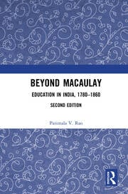
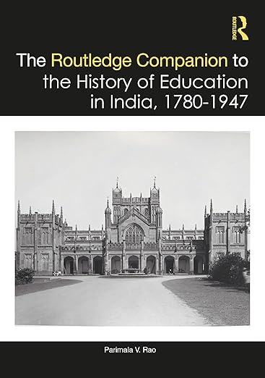
Thank you

